Slide 1
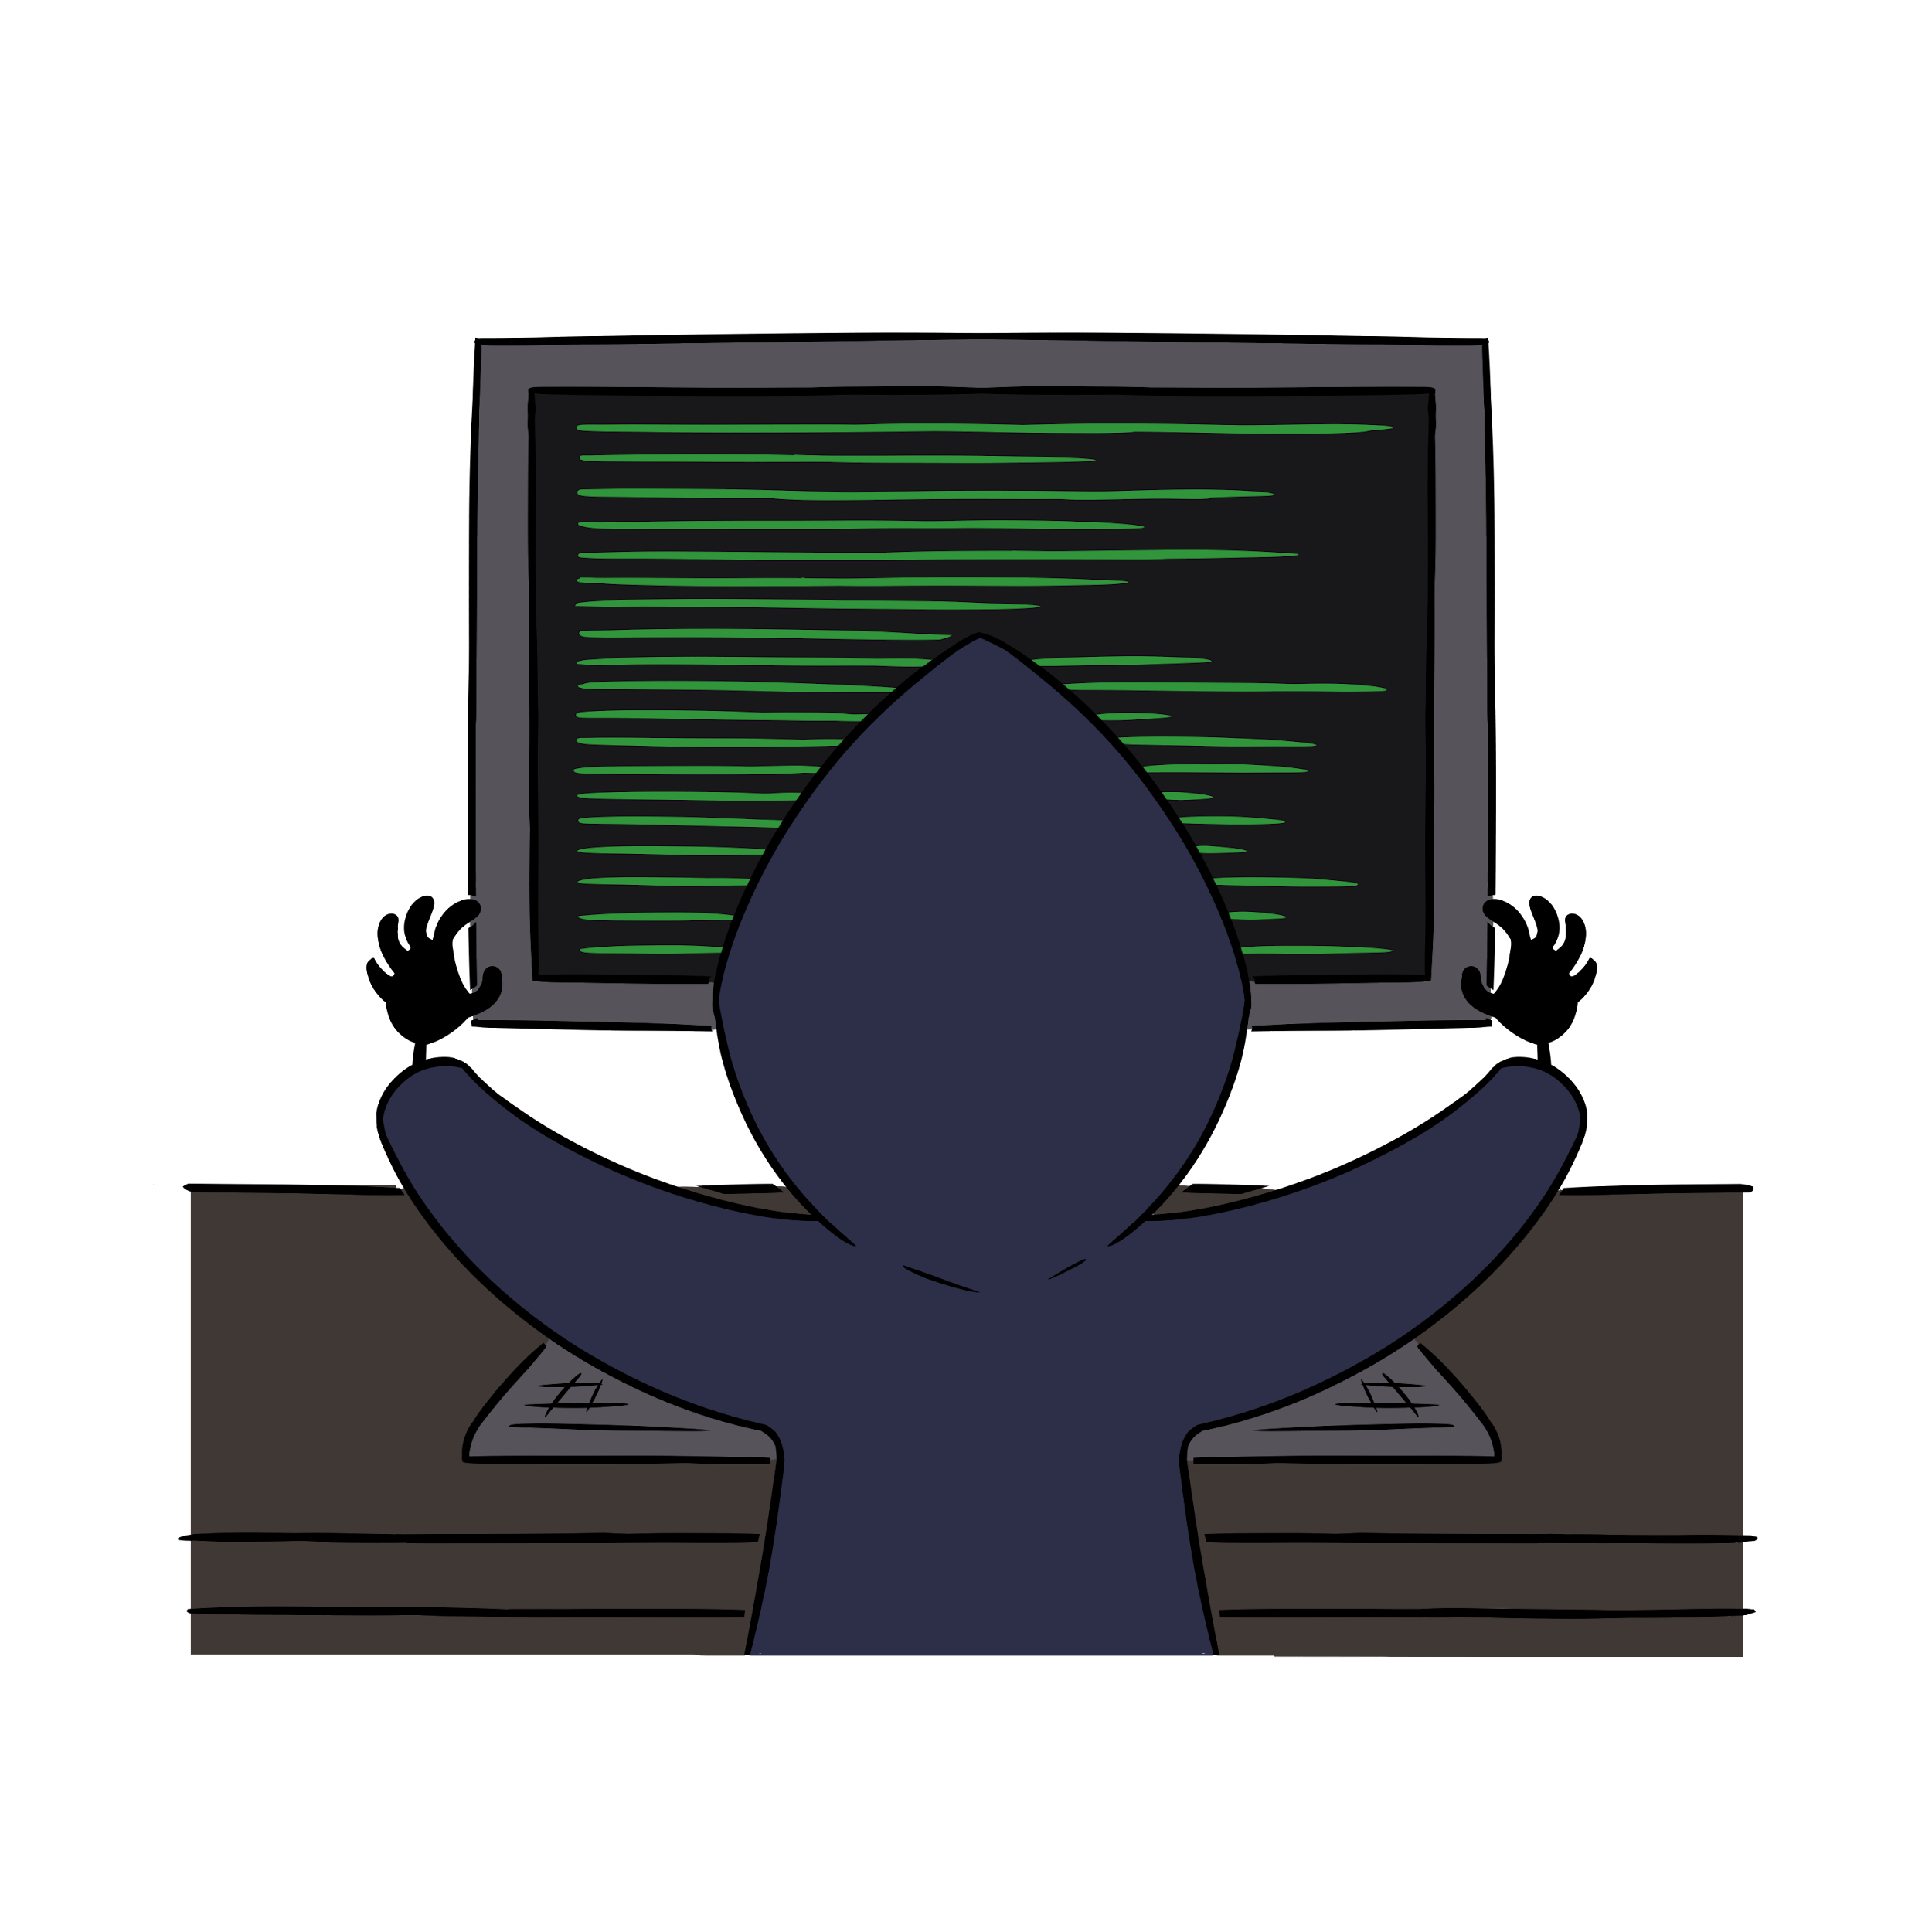
EnRichMinds Intro to Web Apps

Slide 2
GET /license.html
CC BY-NC-SA, See license terms here:
https://creativecommons.org/licenses/by-nc-sa/4.0/legalcode

Slide 3
GET /intro.html
What are we setting out to accomplish with this workbook? Simple! A basic intro to web application testing. We want you to get your feet wet, gain some knowledge about web applications, what can possibly go wrong with web applications, and how attackers can take advantage of that. We're not going to turn you into 1337 hackers overnight. Want to be 1337? Study. Learn. Practice. This is just to give you a taste to see if it's something you'll like doing. We'll start with the framework that we're going to follow: OWASP.
OWASP stands for the Open Web Application Security Project. It is an organization dedicated to securing the security of software through community-driven open source tools and resources, and education and training. There are hundreds of chapters worldwide, each local to the community they're established in. They have an established code of conduct, and operate on four major core values:
Openness: Transparency in everything from code to finances
Innovation: encourage and support innovation and experiments to further software security
Global: Anyone from around the world can join and participate
Integrity: "…Respectful, supportive, truthful, and vendor neutral"

Slide 4
GET /intro.html
The OWASP community focuses not just on web application security, but on software security as a whole, so it includes things like mobile applications too. That being said, web applications are arguably the linchpin of the current economy. Thus, the importance we place on web application security cannot be understated. If we lose faith in our web applications operating in a secure manner, it could be the beginning of a global economic crisis. Even with the number of breaches that occur in a given year and the amount of personal data that is being hemmorhaged on a daily basis, the population at large has still not lost faith in the cyber economy. However, that doesn't mean we still can't do our best to improve the current state of affairs.

Slide 5
GET /lolwut.html
So, what is web application security testing, and how can we go about doing it? OWASP defines it as "a method of evaluating the security of a computer system or network by methodically validating and verifying the effectiveness of application security controls." In other words, we test how an application functions when perceived malicious users try to get the application to do something it wasn't intended to do. Does it print an error? Does it allow us to execute operating system commands? Does it just break down and stop working? These are all valid questions that we try to answer when we test web applications. We can do this passively, or actively.
Passive testing involves simply gathering information about the application. What web pages are there? Are the web pages dynamic or static? What information is displayed on the web page? What information is transferred(but not displayed!) on the web page? All of this information can be gathered just by browsing the website.
Then comes active testing. This is where the majority of the work comes in. Depending on the size of the application and what it does, there could be a few, dozens, even hundreds of web pages to test. Some of this can be automated, and some of it can't. During this intro, we'll use some of these automated tools, and discover manual ways of testing certain things with web applications.

Slide 6

POST /status.php?isactive=true
Passive testing involves simply gathering information about the application. What web pages are there? Are the web pages dynamic or static? What information is displayed on the web page? What information is transferred(but not displayed!) on the web page? All of this information can be gathered just by browsing the website.
Then comes active testing. This is where the majority of the work comes in. Depending on the size of the application and what it does, there could be a few, dozens, even hundreds of web pages to test. Some of this can be automated, and some of it can't. During this intro, we'll use some of these automated tools, and discover manual ways of testing certain things with web applications.

Slide 7
POST /status.php?isactive=true
Wait. We mentioned something about static and dynamic web pages. What's the difference between a dynamic and a static web page anyway? Well, a static web page never changes. It's the same for every visitor that sees it. The HTML (Hyper Text Markup Language) that generates what you see on the web page is always the same
<html>
<head>TEST</head>
<body>Hello there!</body>
</html>
The above is a static web page. If you were to load this into a browser, everyone would see the same exact thing. That's no fun though, right? Who cares if you can deliver the same exact content to millions of people? Certainly not advertisers! Enter dynamic content. Dynamic web page content is constructed on the fly, usually based on information the user is (sometimes unwittingly) supplying. Do a Google search. Dynamic content. Load up Amazon. Dynamic content. Netflix, Snapchat, IG. Log into your banking website. It's all dynamic. The modern web functions on dynamic content.

Slide 8
POST /status.php?isactive=true
So, umm, that's a lot of stuff to test, huh? Luckily, OWASP has a Web Security Testing Guide that we can use to help us work on some of these things. In order to do this, we'll be using a few different tools, and some intentionally vulnerable web applications. There are tons of these vulnerable web applications available for you to download and play with at home. And there are numerous online sources for gaining experience looking at web applications for vulnerabilities. We can only include a couple in the lab environment, but we'll include some links in the reference section. The purpose here is to provide a safe place for you to learn some of these techniques without having to download and run these applications at home. And the folks teaching you this material can even help provide some context, background, and real-world tips and tricks that you can use to help you learn something about web application security.
So where do we start? At the beginning of course...
"'Begin at the beginning,' the King said, very gravely, 'and go on till you come to the end; then stop.'"
-Lewis Carroll, Alice in Wonderland

Slide 9
GET /tools.html
What tools are we going to use to test web applications? We'll use standard tools that anyone can download and use for free. First, we'll use a web browser. There's many to choose from, but Firefox comes pre-installed with Kali Linux, so we'll use that.
We will also use something called a proxy. What's a proxy you ask? Remember those man-in-the-middle attacks we mentioned? A browser in nothing more than a way for us to perform a man-in-the-middle attack against ourselves. We want to be able to see and maybe modify data sent between our web browser (a client) and the server. The proxy will allow us to take a close look at data as it leaves our browser, and as it returns from the server. We can even use the proxy to modify the data if we want. Remember -- dynamic content means it can be changed.
The proxy software we're going to use is called OWASP ZAP. Hey! There's that OWASP acronym again! OWASP currently maintains a piece of software called Zed Attack Proxy, or ZAP for short. It's a very powerful, free, tools that comes bundled with all kinds of neat features to help automate some testing -- with even more features (plugins) available for download. By the end of these labs. You'll be using ZAP like a pro!

Slide 10

GET /recon.py Information Gathering
So, remember that passive testing we mentioned? That's the first step in testing a web app -- I mean after gathering all of your tools, and setting up your work environment, and getting a cup of coffee, and sending some emails, and talking about the latest episode of <insert popular NetFlix binge show here> with your coworkers. That's really the first step. Information Gathering is the first step after all of that other super important stuff. Some of the types of things we do when gathering info about our target are very similar (if not identical) to information gathering when performing other types of pentests. There are other objectives that are just as vital, but we won't be able to cover them all. Below are six basic objectives of the Information Gathering phase of OWASP.
Recon for information leakage
Fingerprint the web server
Enumerate applications
Review webpage comments and metadata
Identify application entry points
Map the application architecture

Slide 11
GET /recon.py Information Gathering
What tool(s) can we use for recon? Right! The same tools we use for recons when performing a pentest: Google, first and foremost, DuckDuckGo, Shodan, etc… Search for information related to the company that wrote the application (that might be good info when creating a password list -- later 😊 ). If using a well-known commercial product, search for default usernames and passwords. Look for documents or sensitive URLs using search operators. WTH are search operators? Glad you asked!
Search operators are keywords that you can apply when searching for stuff on Google or Bing. For example, if you wanted to search for only PDF documents, we could use the filetype: keyword. If you wanted to search only on foo.com you could use the site: keyword. Other keywords include inurl: which will only return results with your search word in the URL and intitle: which will only include results with your search term in the title metadata of the website. Or if you want to take passive to a whole new level, you can use the cache: keyword and only show data that the search engine has cached. That way, you won't actually visit the real website when you click on a search result -- or maybe you want to look at older data. The cache: keyword works for that too!

Slide 12
GET /recon.py Information Gathering
Let's try an exercise using search operators and Google. Try searching for the following things on Google using keywords:
Any URL that has the string /etc/passwd
inurl:"/etc/passwd"
Any PDF document from ___________________. (Pick a random Fortune 500 company.)
site:yourcompany.com filetype:pdf
Any website that has Directory Indexing enabled with the word backup in the URL.
intitle:"Index of" inurl:backup
These are just a couple of examples of different searches you can try. There are dozens of others that might come in handy. Can you think of any?

Slide 13
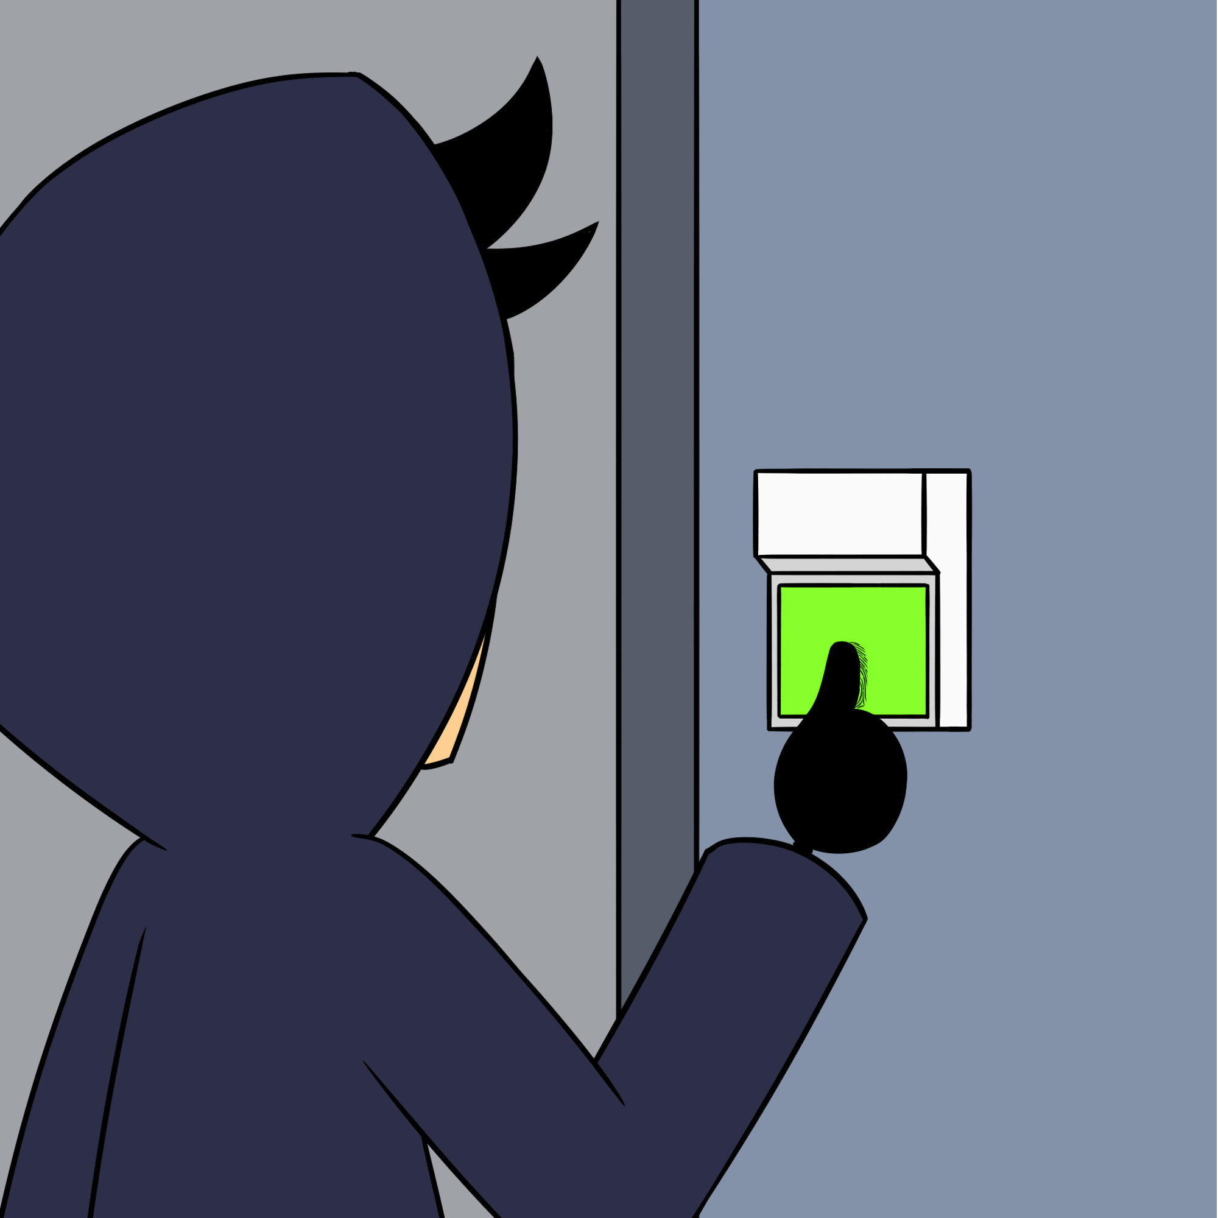
GET /recon.py Fingerprinting
What other types of information can we gather about a web site? How about the "make and model" of the web server -- the server software and it's version information. This is called "Fingerprinting," and you do this using a technique called banner grabbing. Banner grabbing is nothing more than querying an open port on a server and getting it to tell you which type of software is running, and which version of that software is running. Before we talk about how to do that, we need to quickly talk about the types of data you can send to a web server, and in what manner. There are multiple request types. Afterall, HTTP is a protocol that follows standards, so we need to know a little about those standards. Request types in HTTP are also called methods. Below are a couple of different methods, and what they do:

Slide 14
GET /recon.py Fingerprinting
GET: Retrieve the resource specified in the URL. For example, if I sent a GET request to http://foo.com/index.html, I should get back the data that makes up index.html. Web browser software would gather this data, and since it knows HTML, it would then render the content of the HTML code for you to see.
POST: This method is used when you would like the server to take an action on data that you send to it. For example, if I sent a POST request to http://foo.com/login.php?action=login&username=admin&password=password, I am asking the server to use the data provided and perform a computation on that data as specified in the login.php code.
HEAD: This is identical to a GET request, but it doesn't return all data. It only returns data that is located in the HTTP header (we'll get to that in a few). So it shouldn't return any HTML (or other) code.
OPTIONS: Sending this method in a request will tell the server to return all methods that are allowed for a given resource or location.
Other methods include PUT, DELETE, PATCH, CONNECT, and TRACE; but the four listed about should be enough to keep us busy.

Slide 15
GET /recon.py Fingerprinting
What tools can we use to help us fingerprint servers? Well, web browsers for one. But other, CLI-based tools lend themselves to a little more automation, and output that we can modify to be in a useable format. Tools like nmap and nikto are awesome and they're great at automating these tasks. Nmap will even do some of this by default if you specify the scripts option when scanning. But there are also other, non-automated ways of doing this, which help illustrate exactly what is happening when you send a request to the server. Simple tools, like telnet, curl, and netcat. Yes, telnet!
Let's demonstrate this by connecting to one of your vulnerable web applications with telnet and netcat. We'll connect to dvwa.
TELNET AND NETCAT LAB
Can you think of a reason why you’d want to use these tools over the automated awesomeness of nmap or nikto?

Slide 16
GET /recon.py Fingerprinting
We can also use automated tools to fingerprint web servers. Nikto is one of them which we'll talk about shortly, but first, since we're already a little familiar with nmap, we'll discuss it. Nmap is covered in the Pentesting module, but we could use a little bit of a refresher here. From past exercises, we know that nmap comes with preconfigured scripts that we can run to gather information. These are located in the /usr/share/nmap/scripts directory by default, and nmap has over 100 scripts just for HTTP. These can check for specific vulnerabilities, or do things like check for robots.txt files, or list the allowed HTTP methods. We'll try running some of them shortly, but first let's talk about nikto. Nikto is written in Perl, and also is included in Kali Linux. Its functionality is similar to what nmap scripts do, in that it will check for certain well-known vulnerabilities or misconfigurations on a website -- and it's all automated, so all you usually need to know is the IP address or the hostname of the website you wish to target. However, it does also have some advanced features, like being able to send your traffic through a proxy, or only run specific plugins. Nikto is a great tool to use to check for low-hanging fruit, or basic configuration issues. Some of the things nikto checks for are listed below:
Web Server type and version
"Interesting" directories and file names
Directory Traversal
Default web pages and directories
robots.txt file
Well-known and previously published vulnerabilities

Slide 17
GET /recon.py Fingerprinting
Compare that with some of the information that nmap scripts will find by default:
Web server type and version
robots.txt file
Well-known and previously published vulnerabilities.
So, nikto by default will find a little bit more, but remember the price you'll pay for getting that information. Your scans will be louder and the defenders will find you that much quicker. Some of this information is classified by OWASP as Reviewing Webserver META files for information leakage. However, we're still only gathering information using automated tools. We really haven't started any actual "attacks" yet.
Let's do a couple of exercises with nmap and nikto just to get a feel of the types of information they're produce, and the format you'll see it in.
NMAP AND NIKTO LAB

Slide 18
GET /recon.py Enumeration
Enumerating applications on the web server involves probing the server to see if there is more than one web server running, or if there are more than one web application running. It could be a different piece of web server software, it could be the same software running on multiple ports. Or it could be the same software running, but configured to host two applications. But what do we mean by different applications? Well, a web server like Apache or Nginx, or IIS is nothing more than a service that "speaks" HTTP. At the highest level, that's it. There may be dozens or hundreds of features/plugins associated with web servers, like authentication or reverse proxies, or enabling PHP, but all they do is serve up data. It's up to the backend application to provide users with context and an "experience." For example, you could have a Human Resources application that enrolls new employees in a corporate database for things like payroll and insurance, and you could have a Wiki where systems administrators store all kinds of configuration information and HOWTOs on setting up new systems. These are separate applications that could reside on the same web server.
These applications can be split across web servers in multiple ways, including:
Different base URLs:
Non-standard ports
Virtual Hosts

Slide 19
GET /recon.py?base=root.html
Different Base URLs:
Using our previous HR example, that could mean that the HR web application resides at hxxps://www.foo.com/resources, and the wiki application could reside at hxxps://www.foo.com/wiki. In this case, the users would need to know the specific URL in order to be able to access (not necessarily log into) the application.
So, how do we test for different base URLs? There really is no simple way to test for the existence of different base URLs. Unless your target gives you a list of URLs, you're kinda flying blind. You don't know what you don't know. You can take hints from certain information you've gathered previously, like maybe the types of software they use, or the types of products they sell. You can use this information in conjunction with other well-known and commonly used words to create a wordlist to be used in a dictionary-based attack -- that is try hxxps://www.foo.com/hr, hxxps://www.foo.com/bar, hxxps://www.foo.com/wiki, etc… until your wordlist is exhausted.

Slide 20
GET /recon.py?standardPort=false
Non-Standard Ports:
Remember from networking that there are multiple "ports" that an application can run on. The range is 0-65535. And remember that the default ports for HTTP and HTTPS are 80 and 443, respectively. That doesn’t mean that web servers can't run on other ports. You could have your HR application running on port 8080 and your wiki application running on port 9090. Those would be specified in the URL as follows: hxxps://www.foo.com:8080, or hxxps://www.foo.com:9090
How do we test for non-standard ports? This on is a little simpler: Just do a network scan! It'll tell you if a port is open or not. If you've run your scan with scripts and version scans enabled (-sV, -sC) then you should get some information on the type of server and/or web application that is running.

Slide 21
GET /recon.py?isVirtual=true
Virtual Hosts:
Name-based virtual hosts are a way of allowing multiple DNS hostnames to resolve to the same IP, but they would be virtually separated on the web server. For example, hxxps://hr.foo.com and hxxps://wiki.foo.com would all reside on the same IP address. However, they would each have their own web root. This means that if you were able to compromised hr.foo.com, you may then have access to wiki.foo.com as well, since both reside on the same filesystem.
How do we test for virtual hosts? Similar to different URLs, you can create a wordlist and perform DNS lookups, for example nslookup hr.foo.com, nslookup wiki.foo.com. If you receive the same IP address in your response, the systems are on the same server. Additionally, you can try performing reverse nslookups on the IP address to see if you receive more than one response. Lastly, you can try performing a zone transfer. This is a trick that pentesters use to gather DNS information quickly from misconfigured DNS servers. Most DNS configurations have a primary and at least on secondary DNS server. In this case, for the servers to maintain consistent and accurate information, they need to be able to transfer the information stored (called zone information) from one server to another. Most times, servers are properly configured to only allow zone transfers to authorized systems. However, people make mistakes, and this is one thing that can be checked. There are also multiple online tools that can be used to check this information.

Slide 22
GET /recon.py?meta=data
The last Information Gathering section we'll cover before moving on is to review web page comments and metadata. Web pages are made up of code, right? We've briefly covered defining if that code is dynamic or static, but in order for the viewer/user to see anything, there has to be code that generates the web page. That code can be made up of HTML, PHP, Javascript, or any other number of coding languages.
When developing webpages, sometimes developers leave information in the code -- information that they didn't intend for the world to see. This can be simple comments like:
<!-- Development page. Do not submit real data -->
Or something like:
<!-- password to development database is $uper$scretP@55 -->

Slide 23
GET /recon.py?meta=data
So, that's where we'll leave Information Gathering. Like we said, there are other things you can and should do when performing an actual web application test, but since we're just getting our feet wet, we'll move on to something a little more fun. But before we do, let's just mention the stuff we're skipping over:
Configuration and Deployment Management Testing: This involves searching for sensitive information within files that may be accessible via the web, including configuration files as well as backup files that may have inadvertently been left lying around. This also involves trying to enumerate any accessible admin interfaces, e.g. hxxps://www.foo.com/admin. There are other things you can test if you have access to the backend operating system; things like file permissions. However, that may only be doable if you're performing a white-box test. You remember what that is, right?
Identity Management Testing: This objective consists of testing for things like the user registration policy or the account provisioning policy. Other areas of testing include trying to enumerate easily guessable usernames, or trying to determine if there is a username "convention," like first initial, lastname e.g. bjones,jsmith.

Slide 24
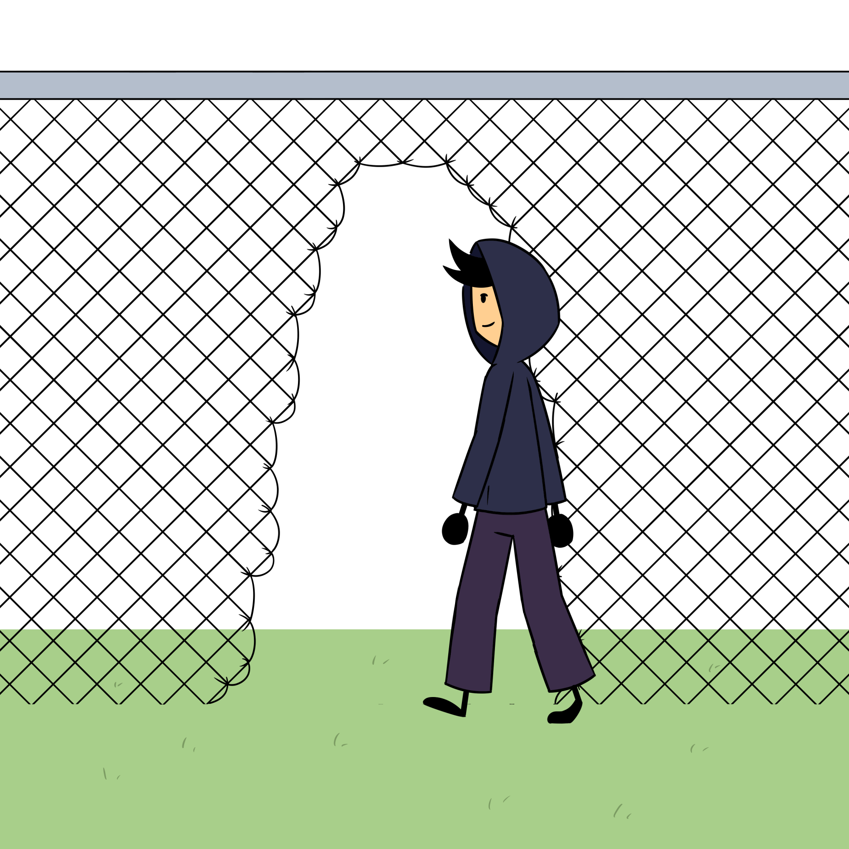
GET /auth.do?myVoiceIsMyPassport
Next comes authentication testing, and this is where things start to get interesting. Authentication testing involves some of the following:
Testing for encryption
Testing for weak or default credentials
Testing for authentication bypass mechanisms
Testing for weak security question, password policies
Testing for weak lockout mechanisms

Slide 25
GET /auth.do?encrypt
Testing for encryption is pretty straightforward, right? Either the communications are encrypted or they're not. We can get into very specific encryption tests, like are they using the proper encryption schemes for sensitive government information, but for our purposes, we simply want to know if the data is encrypted. That means that an attacker would not be able to see the data if they were listening in or performing a monkey-in-the-middle attack. We can test this multiple ways -- the easiest being fire up a proxy and look at the data in the header. The next easiest would be to fire up wireshark and capture all of our HTTP traffic. If we look at a capture of HTTP traffic, we should not be able to reassemble the communications into human-readable data. If we're viewing our data going through a proxy, we need to verify that all data is going to (and coming from) a valid HTTPS endpoint. That means we need to look at the endpoint the data is going to (the first line, usually a GET or a POST), and we need to look at the Referer field as well. If the Referer field is a non-HTTPS endpoint it may be possible to perform an attack called an SSL-strip attack, which is a specific type of man-in-the-middle attack where a malicious user would intercept a request destined for an HTTPS endpoint, and redirect it to a non-HTTPS endpoint, thus allowing them to read all the data.

Slide 26
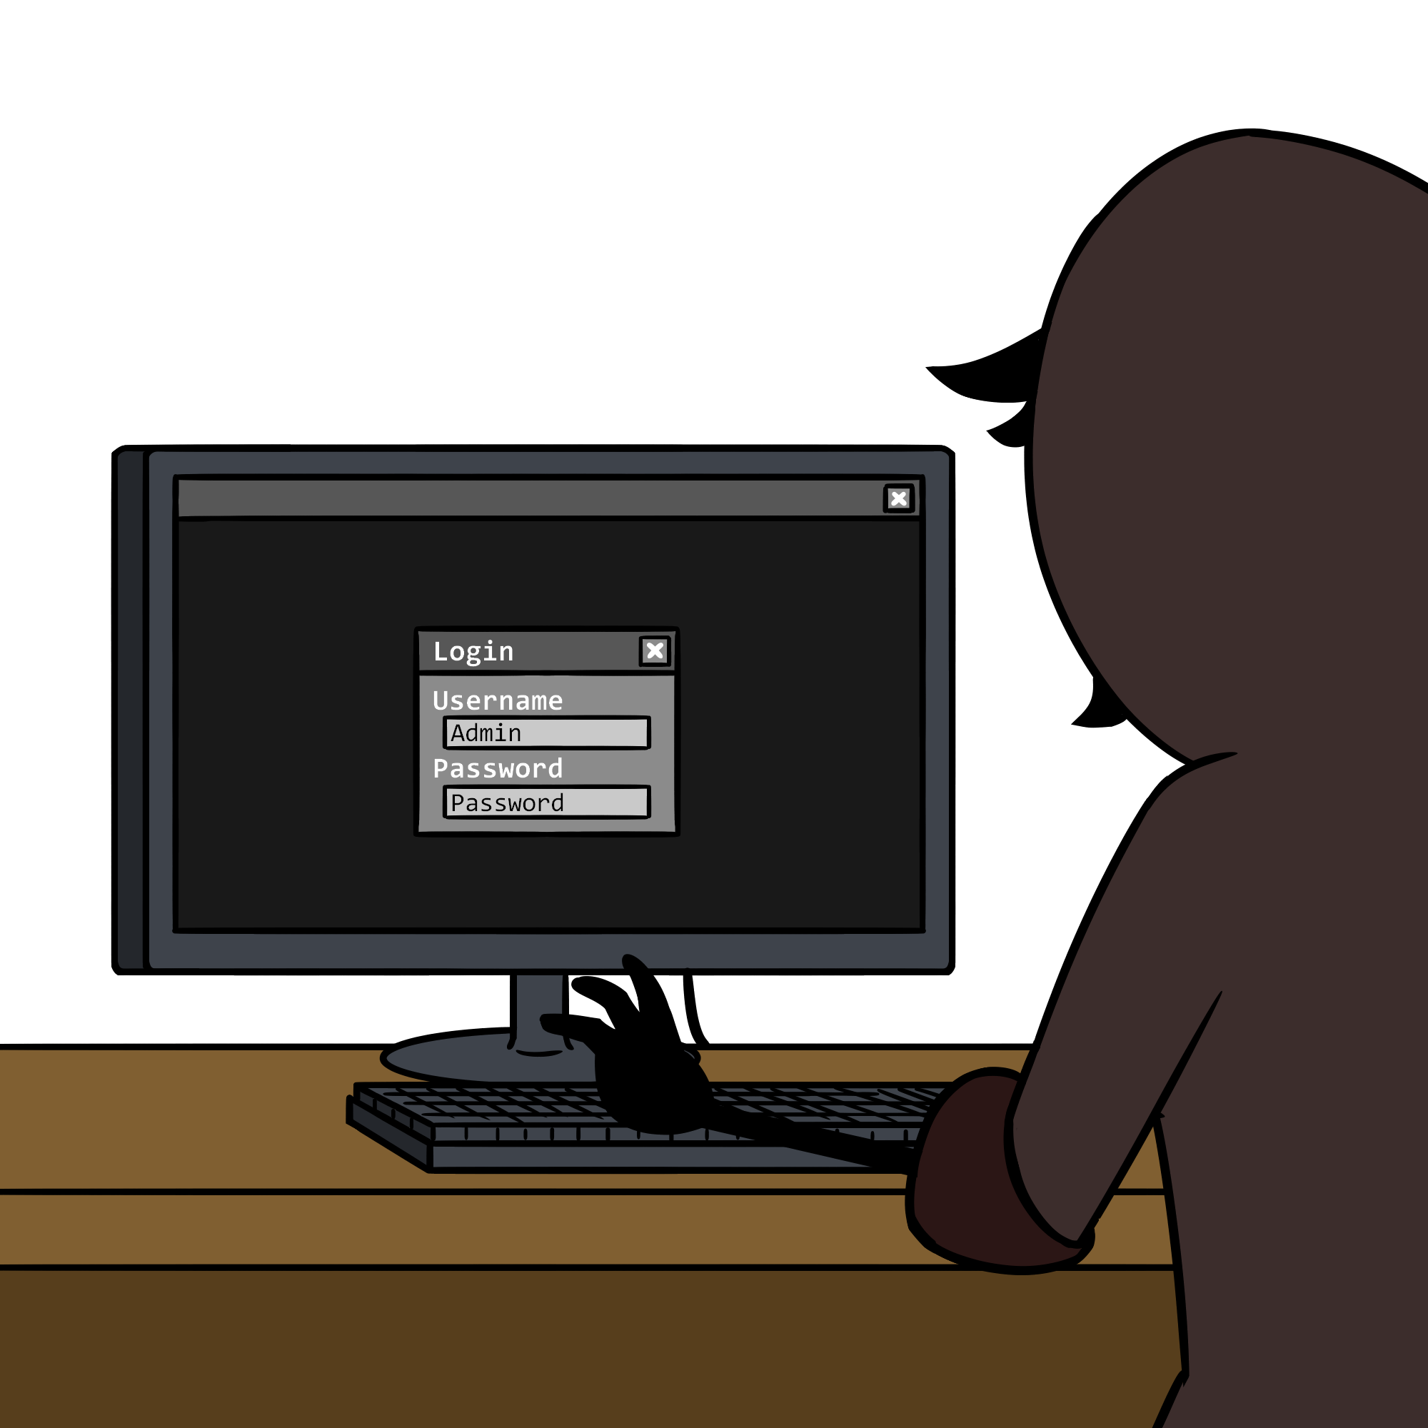
GET /auth.do?default
Weak and Default credentials are one of the ways pentesters frequently use to gain access to a web application. A simple google search for <vendor> default password will provide dozens of links to databases that store all known default credentials to hundreds of vendor devices, from server management software to WIFI access point software. You can also use readily available wordlists for dictionary-based attacks.

Slide 27
GET /auth.do?bypass
There are multiple ways in which you can bypass authentication mechanisms, including forced browsing (or a direct page request), parameter modification, and SQL injection. We'll get to do some of these in a lab!
Forced browsing: Accessing functionality without being required to authenticate. For example, if the website hxxps://www.foo.com was a banking website which required authentication in order to perform administrative functions had another URL, hxxps://www.foo.com/admin.php which did not require authentication, this would be a forced browsing attack.
Parameter modification: We know that parameters can be specified in the URL, right? So, if we pick on our super insecure website again, hxxps://www.foo.com/admin.php?authenticated=no and modify the "authenticated" parameter to be yes and get access, this would be a parameter modification attack.

Slide 28
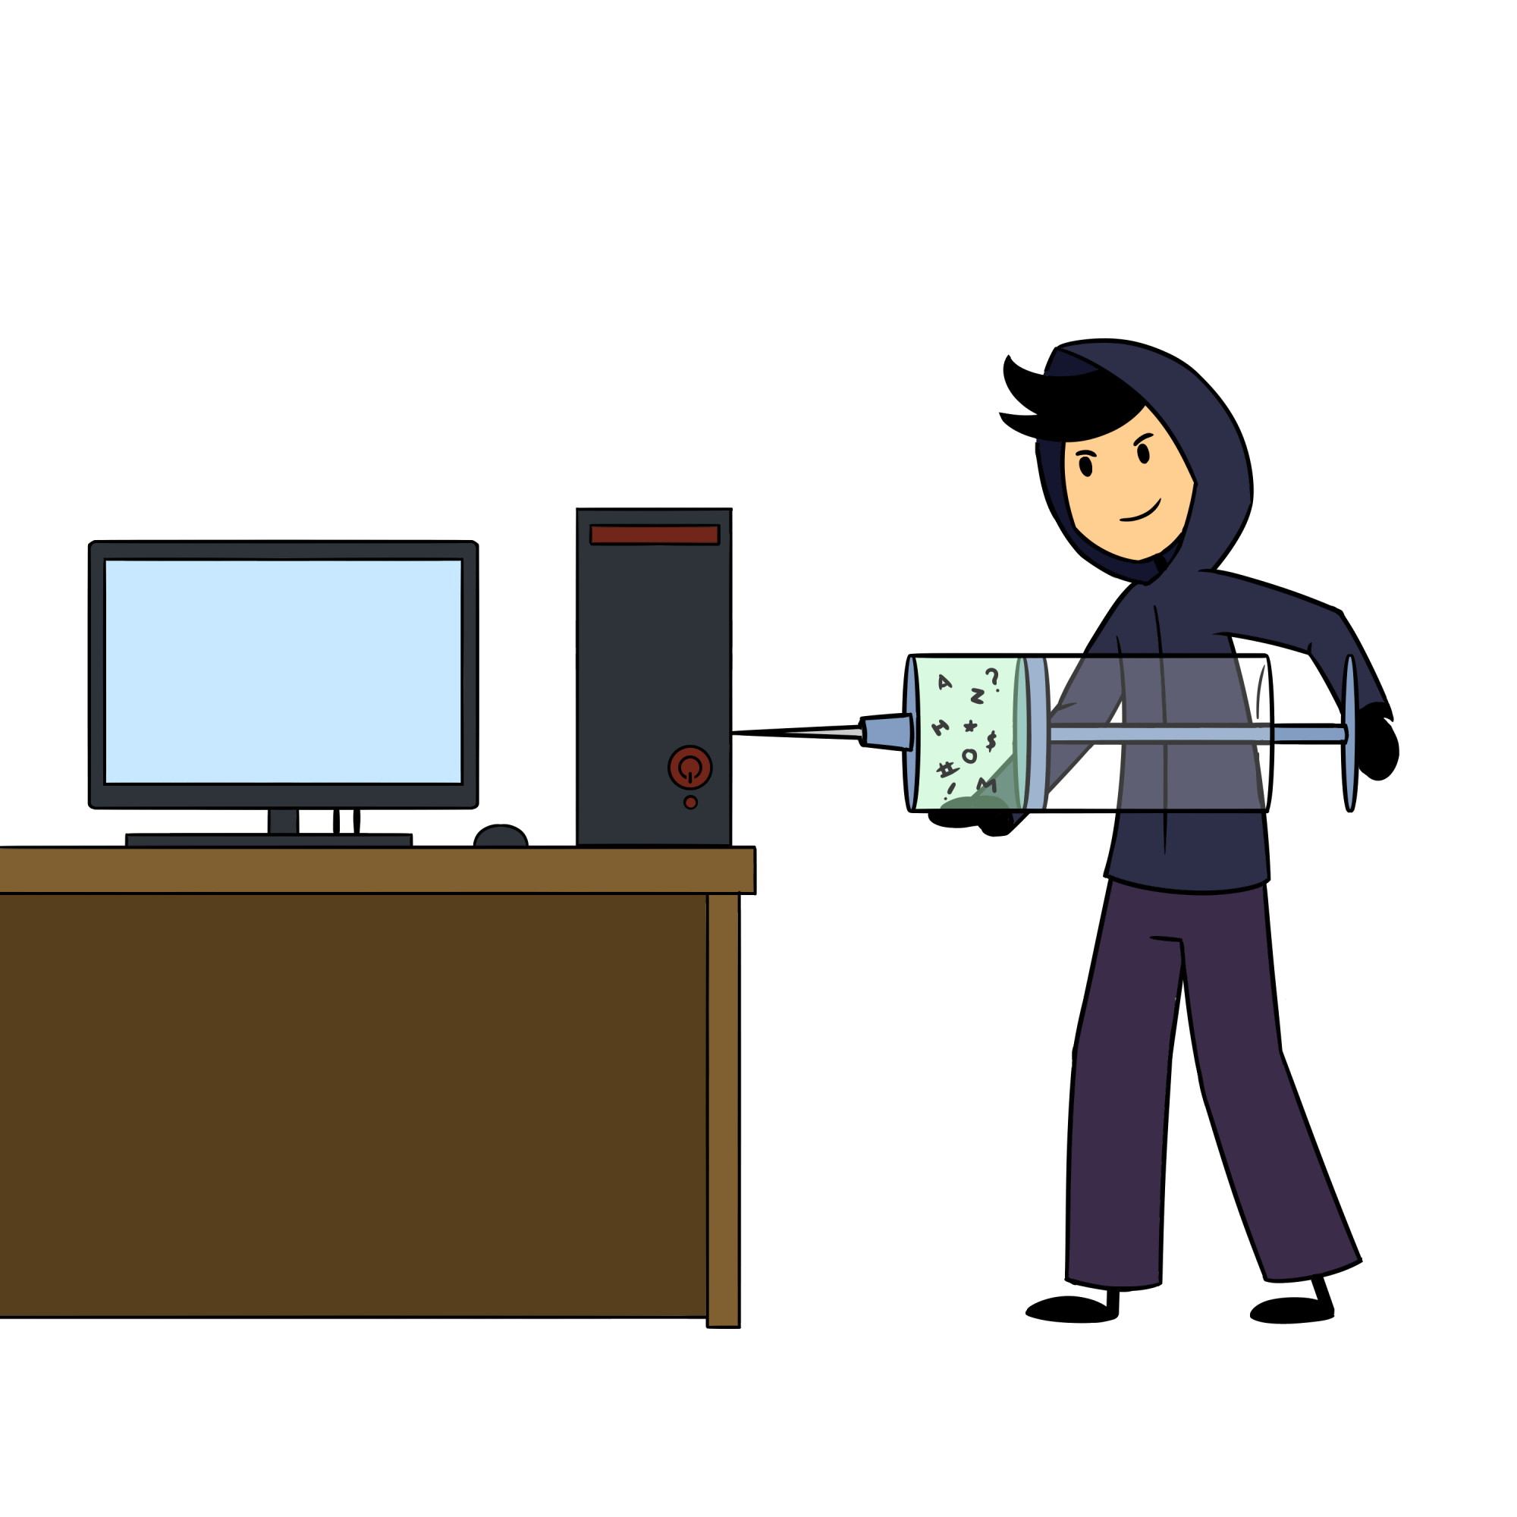
POST /auth.php?inject=true
SQL Injection is a little more tricky to talk about, so we're going to devote an entire section to that. Other parts of a web application may also be vulnerable to SQL injection -- not just the login or authentication functions So any time we see an HTML form and we think it may be accessing a backend database, we test for SQL injection. SQL stands for Structured Query Language, and is nothing more than a way of querying (or asking) databases for information. Some of the more common database queries are:
SELECT: This query gathers information from a database
INSERT: This query will insert data into a table.
DELETE: This query will delete data from a database or table
UPDATE: This query will update information stored in a table

Slide 29


POST /auth.php?inject=true
But wait! What's a table? (besides that thing your mom complains that no one sits at for dinnertime anymore) Well, databases are collections of tables. Tables store records, which are made up of fields. Whoa! That's a whole bunch of terminology that we just threw at you. Take a look at the tables below:

Slide 30

POST /auth.php?inject=true
Both of these tables could be in the same database. Let's call it myApp. Each table would have its own name. We can call the top one users and the second one config. So, we've got a database named myApp with two tables: users and config. Each table is made up of records (a fancy way of saying rows -- each has 3 in our case) that are made up of fields. The field names are the column headers. So, for example, in the users table, we've got fields named userID, username, password, fName, and lName. Each field has a value in it, and these value types are configured when the database administrator configures the database. Some field value types are listed below. Can you identify which types are used in the tables above?
INT: Integers
FLOAT: Floating point numbers
VARCHAR: Strings up to a certain size
BLOB: Used for large binary objects (like images)

Slide 31
POST /auth.php?inject=true
So, getting back to querying databases for information, knowing which types of information might be returned, or possible inserted into a database is critical to working with databases. For example, if we were to run the following query:
SELECT username, password FROM users WHERE username='bsmith' AND password='password1';
This query would return one record, which consists of fields that have INT and VARCHAR types in it. This query is also one that might be used as part of a login function for a webpage. If the user enters a correct username and password, the result would be a TRUE statement, and would allow the user to log in. If, however, the user entered an incorrect password using this query:
SELECT username,password FROM users WHERE username='bob' AND password='smith';
This query would return FALSE, and not allow the user to log in.
Since username and password fields on webpages are controlled by users, their input should not be trusted. What if a malicious user manipulated a username and password query to the following:
SELECT username,password FROM users WHERE (username='' OR 1=1) AND (password='' OR 1=1);
If you remember your PEMDAS and your Boolean arithmetic, then you can see that this statement evaluates to TRUE as well.

Slide 32
POST /auth.php?inject=true
There are countless ways to test for and verify that a web application is susceptible to SQL injection. Luckily, we can use applications to help automate the boring stuff -- otherwise, we'd be testing forever. Will the automated tools catch everything? Nope. But they're a good start, and they help validate or rule out the low hanging fruit. We'll still be using tools like web proxies to help us capture and evaluate traffic, but we're going to add another tool into the mix. It's called SQLMap. SQLMap is an open source tools that you can use to automate a lot of sql injection testing -- and it's even got some cool features, like being able to run OS commands, or even get a "shell." It uses some trickery to do it, but the first time you get a "shell" through a MySQL database is pretty awesome.
<SQL injection and SQL map lab>

Slide 33
GET /authorize.html Authorization Testing
Remember that Authentication and Authorization are different, right? Authentication is verifying who you are using certain identifying information such as a username and password, or an ID card. Authorization is verifying which information you have access to, or what you're allowed to do. Let's use a driver's license as an example. The license itself serves as a means of identification (or authentication) by way of a picture. However, it also serves as a means of authorization. It authorizes you to operate a moving vehicle -- and depending on the type of driver's license it is, you may be authorized to do different things, right? You may have a provisional license, that only authorizes you to driver during certain times of the day. Or, you may have different "classes" of license which may authorized you to operate a motorcycle, moped, or commercial vehicle.
Well, depending on the web application, there may be different "classes" of users who are authorized to do different things. For example, IP camera software may have a "guest" user account that only allows those who have authenticated to view the current camera picture. It could also have an "admin" account that allows authorized users to modify camera settings or add/delete users. If web applications are not written properly, this could allow one class of user to perform operations or see data that only another class of use should be seeing. That's only one example. There are many other cases where certain users are authorized to perform a function that others can't. A couple of the things we can look for when testing authorization are:
Directory traversal
Insecure Direct Object References (IDORs)

Slide 34
GET /authorize.html Authorization Testing
Directory traversal is when you are able to access data or files outside of the current directory, or the web root. For example, if the URL hxxps://foo.com/data?file=home.html pointed to a particular HTML document but was susceptible to directory traversal, an attacker might be able to substitute the following the gain access to sensitive information: hxxps://foo.com/data?file=../../../../../../etc/passwd. Remember what the double dots signify in Linux? Remember what the /etc/passwd file is? This particular directory traversal attack would go up a directory 6 times, and then go to /etc/passwd and perform an action on that file.
Insecure Direct Object References are when a malicious user is able to access an object directly by modifying an attribute. This could be an item in a database, items stored on the file system, or an item stored elsewhere. For example, in the following URL, let's assume that you clicked on a link in a web store to view an item, in this case, it's item 9876: hxxps://footsore.com/viewItem?itemNumber=9876. Without being provided a link to other items, you may be able to modify the itemNumber attribute to 9875 or 9877 and be able to view data that you might not be authorized to see. Consider another example for a website that redirects you to your profile page after you log in: hxxps://foo.com/profile?userID=9876. On that page, you are able to perform certain actions, like change your password, or view other sensitive information. This information should not be viewable by others, and others should not be able to view your information. What would happen if you were able to modify the userID attribute and view the information of other users? These are both examples of IDOR authorization weaknesses.

Slide 35
GET /session.html Session Mgmt Testing
What is a session when we're talking about web applications? Well, remember that HTTP is a stateless (or sessionless) protocol, meaning that if you were to visit hxxps://www.foo.com/login.html and login, and then visit the same page again, HTTP, by itself, would not be able to know that you've already logged in, and you'd have to log in again! So how do modern web applications know and keep track of the fact that you might have logged into a website? Cookies! Cookies keep track of all kinds of things, like login sessions, whether you've visited a webpage before, application preferences, and other things. And cookies don't have to be limited to just the website you're currently visiting. Facebook may be able to track that you've visited a web page outside of Facebook because it can read cookies set by that other website. Have you ever done a search on the internet and then been inundated with ads related to that search? Cookies! They're everywhere. The modern internet couldn't function without them. This is just one example of things we can look at when evaluating session management. Some others include:
Session Fixation
Cross Site Request Forgery
Session Timeouts and Expiration

Slide 36
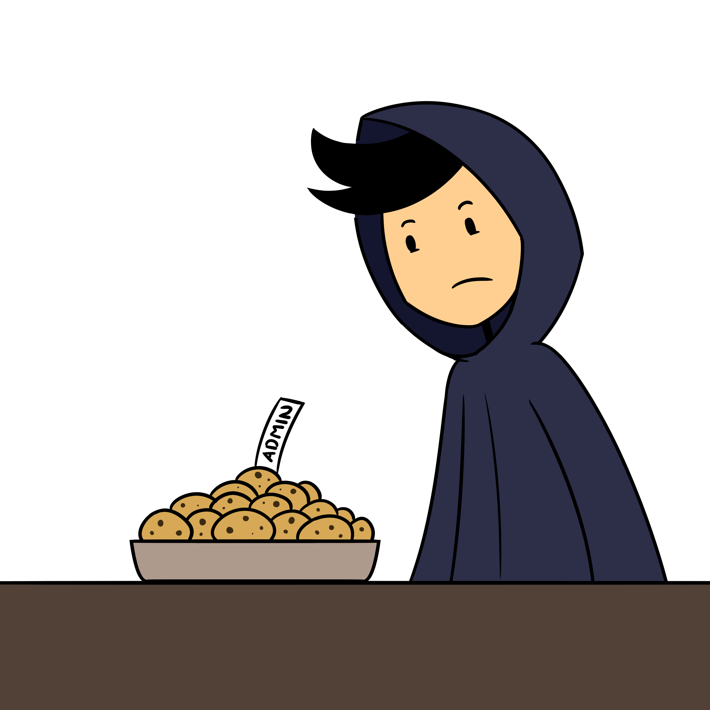
GET /session.html Session Fixation Testing
Session fixation vulnerabilities are associated with cookies not being invalidated and renewed once a user performs an action that requires them to authenticate. If a web application is coded properly, a session cookie will be assigned once a user visits a page. If the user then logs in, that original session cookie should be invalidated, and a new cookie should be issued. But how could an attacker take advantage of this? If an attacker were to send a valid session cookie to an unsuspecting user (say via phishing) and that user logs in, the new authorization attributed would then be applied to the original session cookie, and the attacker could then use that cookie to gain access to data that they should not have access to.

Slide 37
GET /session.html CSRF Testing
A Cross Site Request Forgery (CSRF, or XSRF) is another type of attack that requires an unsuspecting victim to click on a link. It also requires the attacker to know how the web application works and that session information relies on information known by the browser. Hence, the vulnerability is taking advantage of the trust relationship established between the vulnerable site and the user's browser. Let's draw out a scenario to illustrate how this might work. You're a user of Foo Bank's online banking app that helps make home banking easier. You're able to transfer money between accounts and pay bills online. You're doing some online banking one day and you transfer money from one of your accounts to a family member for something they helped you out with a while back. When you click on the "Transfer" button, the HTTP request looks like this: http://foobank.com/moneyXfer?destAccount=123456789&amnt=1000. Now say that there's an attacker, who might know that you use Foo Bank's services and they set up an account to become familiar with the application. They now send you a link disguised as something else that translates to this: http://foobank.com./moneyXfer?destAccount=987654321&amnt=5000. You happen to be logged into your bank account when you click the link, and POOF!. There goes $5000. This is just one example of CSRF.

Slide 38
GET /session.html Session Timeout Testing
What about Session timeouts and expiration? What does that mean? Well, a session timeout is designed to "automagically" log you out of a web application if it notices you haven't been active on the site for a given amount of time, e.g. 15 minutes. This is to protect you in the event you leave a session logged in and walk away from your computing device. Session expiration can also be referred to as session logout, and is slightly different only in the actions taken by the user. In session timeouts, the user doesn't perform any action, and the session identifier is invalidated. With session expiration or logout, a user actively clicks a logout (or other similar button) to log out of the application. This should also invalidate a session identifier.
Just like the results, the testing actions for each of these is similar. A tester will log into an application and receive a session identifier. If a session timeout is supposed to be configured, the tester will wait for the specified period of time, and then check to see if they still have access. When testing logout functionality, a tester will log in and receive a session identifier, then log out. If the logged in session identifier still allows the tester to access the application, logout functionality is not working properly. Remember! Any change is authorization status should provide the user with a new session identifier which denotes the access the user is supposed to (or not supposed to) have.

Slide 39
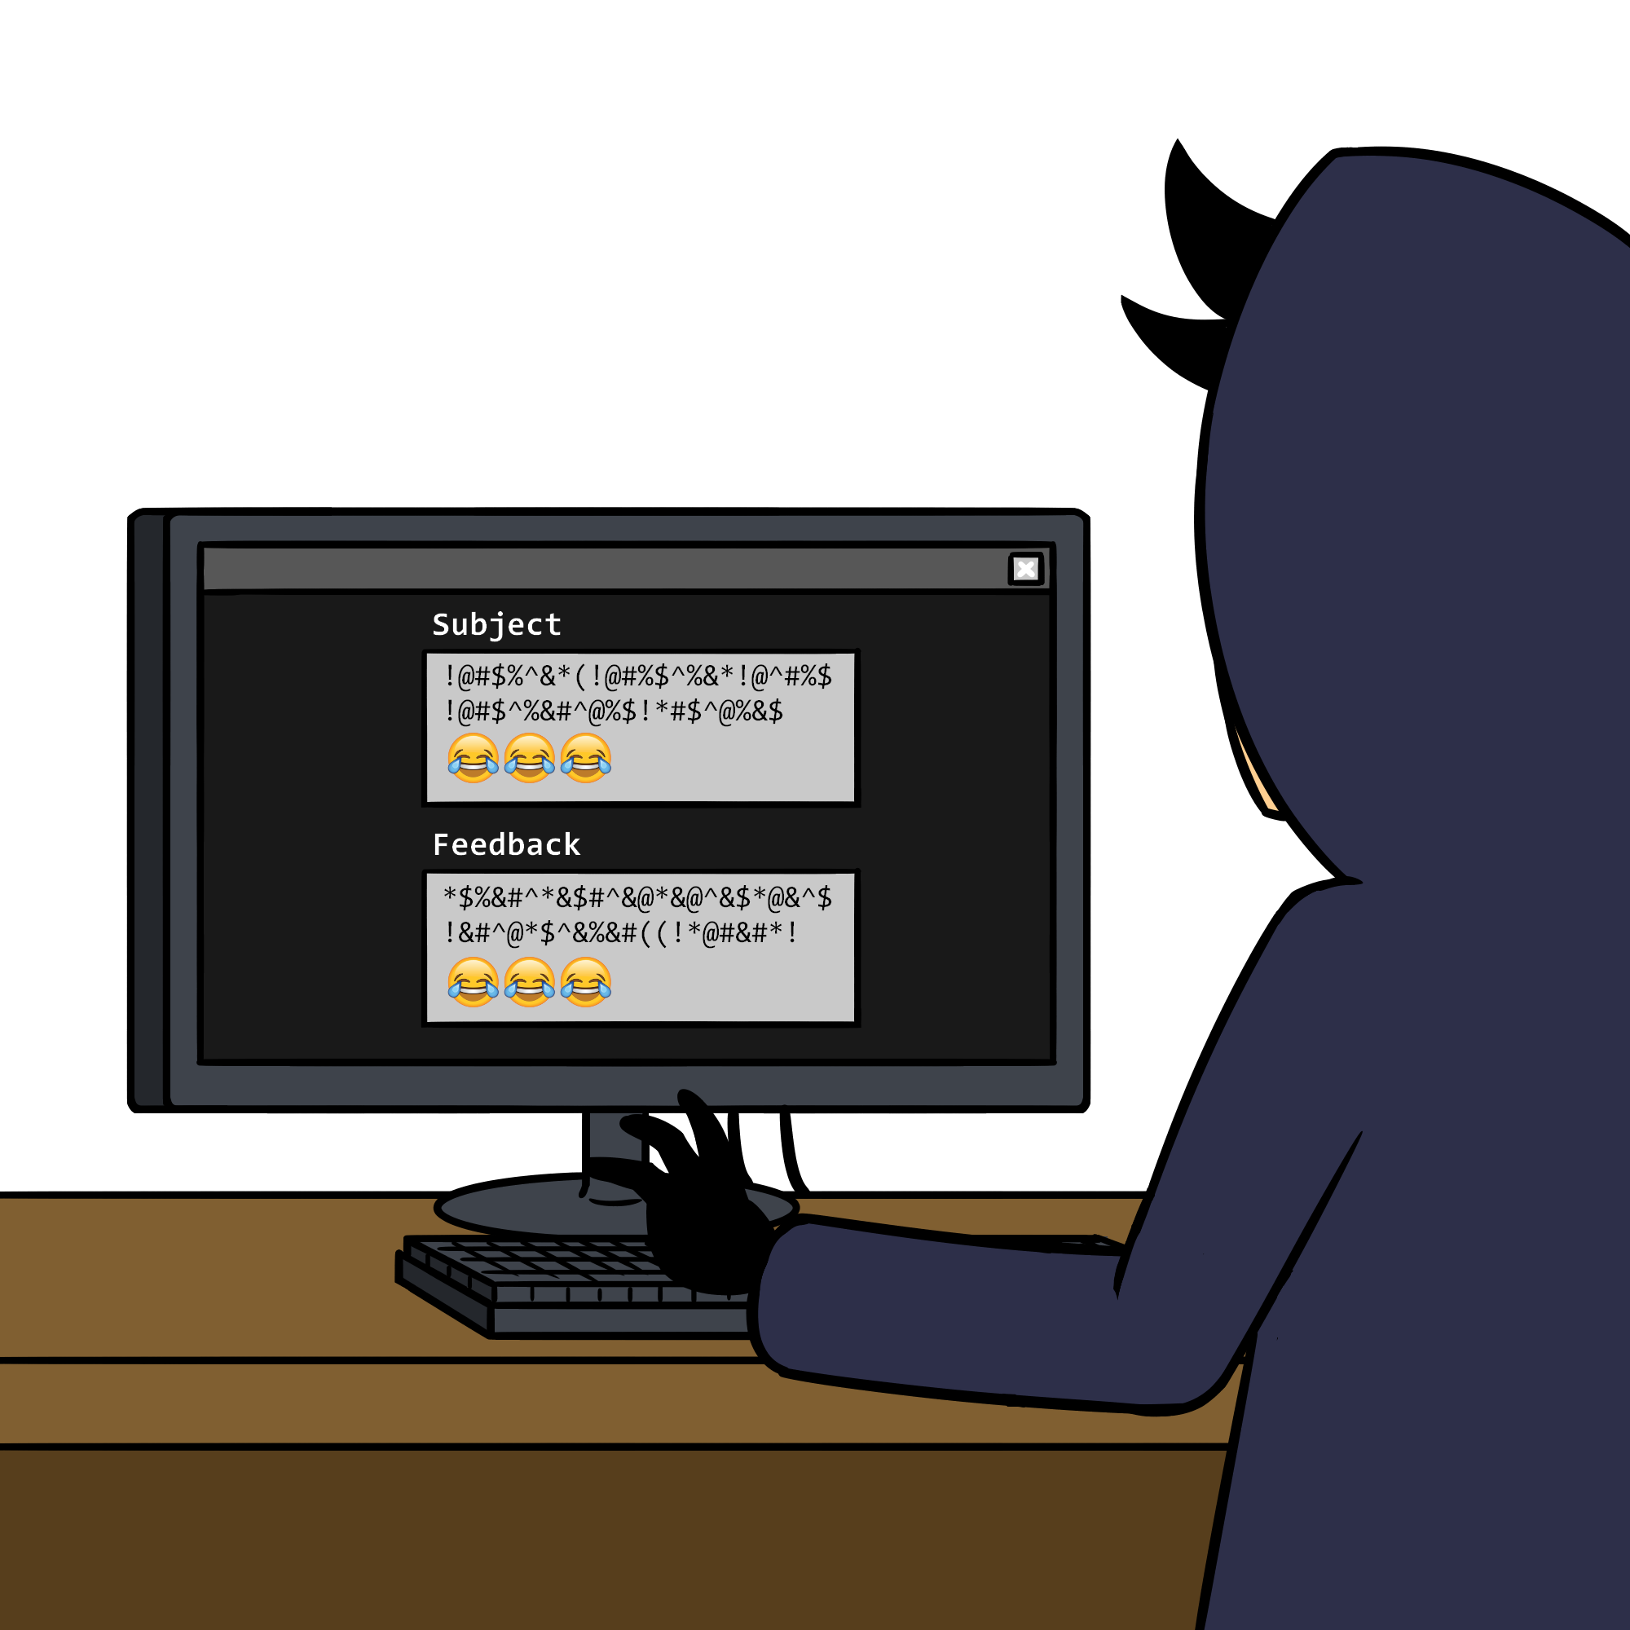
POST /input.php?validate=true Input Validation Testing
Input validation testing is where testers could spend the majority of their time, especially in modern robust web applications, which have multiple workflows, pages, and fields. Remember that users cannot be trusted, so testers need to look at different ways that user input could cause web applications to do things they weren't intended to do. There are so many different types of input validation, and we've actually already covered one. Can you guess what it is? Right! SQL injection. That's just one type of injection attack testers can check for when looking at web applications. Other types of injection attacks include the following:
Cross-Site Scripting (XSS)
LDAP
Command
Code

Slide 40
POST /xss.php?exploit=true XSS Testing
Cross-Site scripting attacks are attacks against client software, like web browsers, and take advantage of weaknesses in server software to execute code (usually javascript) on client systems. Kinda confusing at first, yeah. But hang in there. It'll get clearer in a couple of minutes. There are three main types of cross-site scripting attacks: stored, reflected, and DOM-based. The first two are fairly self-explanatory. Stored XSS is an XSS attack that is stored on a server (think blogging comment section, or bulletin board). Anyone who visits that site will have the attack launch against their client system because it's stored on the server for all visitors to view. A reflected XSS attack is not stored anywhere. It's sorta in the ether, and like CSRF attacks, relies on a user clicking on a link that you send them. That's the reflected part. An attacker sends a link to a victim, and it's reflected from them to the server, then executed on their client system. DOM-based XSS is a fully client-side attack. A DOM, or Document Object Model is a type of "scripting" language that takes data received from a server and translates it into a specified format once the code reaches the browser and then displays it to the user. Clear as mud, right?
INSERT XSS labs from either DVWA or Mutillidae.

Slide 41
POST /xss.php?exploit=true XSS and LDAP Testing
Cross-Site scripting attacks are attacks against client software, like web browsers, and take advantage of weaknesses in server software to execute code (usually javascript) on client systems. Kinda confusing at first, yeah. But hang in there. It'll get clearer in a couple of minutes. There are three main types of cross-site scripting attacks: stored, reflected, and DOM-based. The first two are fairly self-explanatory. Stored XSS is an XSS attack that is stored on a server (think blogging comment section, or bulletin board). Anyone who visits that site will have the attack launch against their client system because it's stored on the server for all visitors to view. A reflected XSS attack is not stored anywhere. It's sorta in the ether, and like CSRF attacks, relies on a user clicking on a link that you send them. That's the reflected part. An attacker sends a link to a victim, and it's reflected from them to the server, then executed on their client system. DOM-based XSS is a fully client-side attack. A DOM, or Document Object Model is a type of "scripting" language that takes data received from a server and translates it into a specified format once the code reaches the browser and then displays it to the user. Clear as mud, right?
LDAP (Pronounced El-Dap). Is an authentication and authorization protocol used for centralized management of large organizations consisting of people, groups, computers, and other objects. Its short for Lightweight Directory Access Protocol, and it is the basis for the Microsoft Active Directory architecture. It is prone to injection in the same way that SQL is prone to injection. IF an attacker can inject characters or code into an LDAP query, they may be able to view information they are not authorized to see.
INSERT XSS labs from either DVWA or Mutillidae.

Slide 42
POST /xss.php?exploit=true Command Injection Testing
Command injection attacks are just what they sound like -- a way for attackers to inject (run) code or operating system commands -- sometimes even returning the results to the web browser. Consider a web page constructed for a team of network administrators to test connectivity to systems, switches, routers, etc… They enter an IP address or hostname into a form field, and press submit, and the application goes off and runs the ping command against the system, and returns the results. Now, think back to our discussions on linux cmd line and think about ways that you can run more than one command on a single line. For example, the command cd;ls would run the command cd, then immediately run the command ls; so in this case, it would return you to your home directory and then list the contents. Now think about how the network connectivity application functions. If you were to enter foo.com into the form field, it probably runs ping foo.com and then returns the results. Now consider you enter foo.com;id -a. What would happen? Well, if the application isn't coded properly, it's possible that the application would run ping foo.com;id -a, and then return the results. Now think about some more nefarious things you could do, like reading files with the cat command, or executing other commands, like netcat. Things can get pretty interesting when you're talking about command injection vulnerabilities.

Slide 43
POST /xss.php?exploit=true Code Injection Testing
Code injection has two sub-attacks, local file inclusion (LFI), and remote file inclusion (RFI). Local file inclusion if often used in conjunction with other types of attacks, like directory traversal to read files on the file system. In some instances, they could be combined with functionality that the developer may have purposefully added, like file uploads. For example, some web applications may request you upload documentation to validate a set of data. If an attacker is able to upload a malicious file and then use a LFI exploit to execute code on the target system. RFI vulnerabilities are found very infrequently, and allow an attacker to have a target system execute code that resides on a system under the attacker's control. Application settings that allow this type of functionality are rarely enabled, and are usually disabled by default.
Lab on Command Injection and LFI

Slide 44
POST /logic.php?exploit=true Business Logic Testing
The next thing testers look at is something called Business Logic, which is just a fancy way of saying "how the application works." One of the ways applications are developed is called a Use Case. A use case is basically the logical flow of a feature of an application. For example, a use case for a banking web application could be a money transfer. From there, sometimes storyboards are developed to illustrate how a user would interact with this use case. In our example, it might be something as follows.
1. User Logs In | 8. Application opens "Transfer Money" screen.
2. Application checks accounts owner by logged in user. | 9. User is asked to enter and verify both the source and destination account
3. Application lists accounts verified in step 2. | 10. User clicks "Transfer Now" button
4. User views Account summary | 11. User is prompted with an "Are you sure” button.
5. User clicks on Savings account | 12. User clicks "Yes"
6. Application opens account screen. | 13. Money is transferred from Account A to Account B.
7. User clicks on "Transfer Money" button | 14. Application returns to Account summary screen.

Slide 45
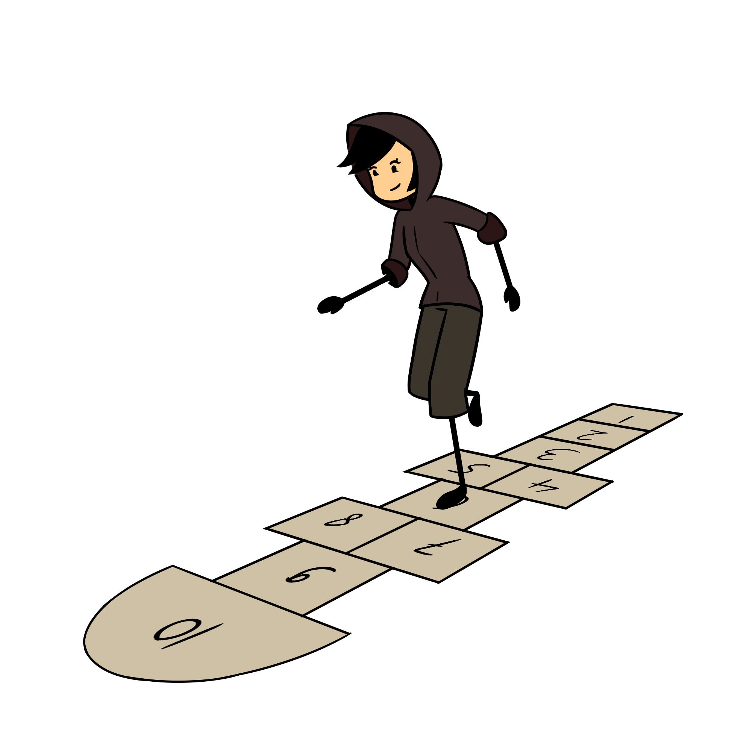
POST /logic.php?exploit=true Business Logic Testing
Well, one thing that attackers or testers can do is come up with a corresponding "Misuse case." What if an attacker could bypass the login function in step 1, or the authorization function in step 2? What if the attacker could bypass the "Are you sure" in Step 11? This is just a simple example of testing business logic. You can imagine in a fully functioning web application, like a banking app, there could be hundreds or thousands of business logic flows that need to be tested.

Slide 46
GET /error.log Error Handling
Testers can also look at Error Handling -- simply put, how does the application behave when an error is encountered. Does it barf a whole bunch of debugging code to the browser? Does it allow testers or attackers to elicit information from the server? Simple examples of this include items like fingerprinting SQL database information, like "make and model." SQL servers respond differently depending on what software is running. For example, MySQL/MariaDB responds with something like "You have an error in your SQL syntax; please check the manual that corresponds to your MySQL/MariaDB server version…" Like, WTH!? It says exactly what the backend database is in the error message. Pretty good clue for attackers, I'd say. Other databases have similar identifying error messages.
Consider also, a simple login page with a username and password field. If you were to enter "admin" for password and "password1" for a password, and you received the following error:
The username entered is incorrect. Please try again."
What is the problem with that error message?
Right! We can use that to narrow down valid user names and passwords for the application.

Slide 47
GET /error.log Error Handling
Developers can also make simple mistakes that could have huge implications. Most software applications have different levels of error messages to help both developers and other figure out what's going on. These generally range from critical-type error messages like "ZOMG!!! The server is down!! Do Something! Anything!" to more debugging-type error messages that could be as verbose (that's the word we usually use when talking about logging and output) as "User bob tried to log in with password 'password1' and the application crashed. The last file accessed was filex.library, and the error occurred on line y."
So, best practices usually state something along the lines of only give the user as much information as necessary so they can correct the problem themselves. An example of this is commonly seen when you fat-finger your password for a website: "An incorrect username or password was entered." This allows the user to correct the problem without letting an attacker know whether or not the username entered was a valid username. And applications usually have a way to scale back the logging (or even disable it) so no sensitive information is exposed.

Slide 48
POST /encrypt.do?encryptData Encryption
Remember when we tested for encryption during the authentication phase? Well, we should technically be testing for encryption throughout the entire application. We're going to only briefly touch on this subject, as we don't have any labs designed specifically for it. That's not to say encryption is any less important. It's critical to how the Internet functions today. It keeps (well, tries to, anyway) all of our information from being exposed to people who shouldn't see it. The most vital thing encryption protects us against is a man-in-the-middle attack. Remember way back when we talked about networking? What's a MITM attack again? Right! When a malicious user inserts themselves between two endpoint that are communicating via a network. This could be a malicious use on a subnet viewing all traffic going to the gateway, or it could be something on a grander scale -- like an ISP intercepting network traffic to present pop-up messages to their customers (Yes. This has been done before).
But we also want to make sure that any data being stored by the application is being done so properly -- especially for things like passwords (Remember all of those breaches where users' unsalted passwords were compromised?). Passwords should be hashed (and SALTED!!!), not encrypted. And if you must encrypt data, do so with a key that cannot be compromised easily (like in source code, or in a Microsoft Technet article, See: GPP Passwords)
Always make sure that data traversing the network is encrypted. And always make sure that sensitive data being stored (at rest) is encrypted (or hashed).

Slide 49
GET /client.html Client-Side Testing
The last thing that we're going to test for is client-side vulnerabilities. Some of these, like XSS and HTML injection have been covered previously. The biggest thing to hit the web in recent years has been WebSockets. WebSockets are what HTTP wants to be, but isn't. Remember how we talked about HTTP being sessionless? WebSockets fixes (we'll say fixes, but I'm not sure that's the right word) that. When using WebSockets, it creates a full-duplex (what's that mean again, network folks?) connection between the client and the server -- meaning that the server can send the client information without the client needing to initiate a request.
But remember, more functionality means more possible problems. Features==exploitation paths! WebSockets create kind-of a nesting problem in that a lot of the stuff we tested for with standard HTTP, we now need to test with WebSockets -- things like Authentication and Authorization, and Input Validation. Yay! We get to do things all over again!

Slide 50
GET /done.html Wrapping up
There are other items we want to test for, like making sure cookies are stored appropriately and not accessible by entities that should not have access to them, but this essentially wraps up our testing. You’ll notice that we put a lot of work into planning and recon. As testers (and, really, in life in general), the more you prepare, the more successful you’ll be when it comes time to exploit a vulnerability. So, take time to prepare and plan accordingly.
We also did not really cover how to foil all of these attacks. The OWASP documentation has some great insight into that as well. If you plan on being a security testers, or even a software developer, knowing how the bad guys think will help you do your job better.

